Slide 1
Jessie Ma Senior Project Spring 2024
Building motion sensors to create music from movement

Slide 2
Introduction
This project’s goal was to map motion captured by sensors to sound and music. I wanted to explore the intersection of technology and art, as well as gain a deeper understanding of the ways technology physically works in tandem with our everyday lives.
Today, motion capture technology can be found everywhere— on our phones for tracking orientation and navigation, on fitness watches, etc. This technology is used in many applications: measuring movement in sports for injury diagnosis or optimization of training; in film and the entertainment industry for VFX or animating 3D characters; in medicine to aid patient recovery or in physical therapy treatments, for example, analyzing the gait of patients to track the progression of diseases that impair movement. I hope that this just slightly simpler use of motion sensors allowed me to gain insight into the many other applications of motion sensing in other fields.

Slide 3
.
General Workflow
General Workflow
Arduino:
accelerometer/
gyroscope data collection
Python:
mapping data into music production

Slide 4
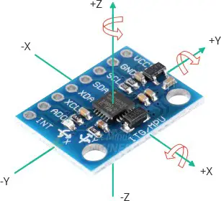
Arduino: accelerometer/gyroscope data collection
Parts used:
Arduino Uno
Microcontroller
MPU6050
6-axis motion sensor:
Accelerometer measures acceleration
Gyroscope measures rotation
Arduino IDE:
can upload C++ sketch to the Arduino Uno
Sending Data:
Serial communication to send data between Arduino and Python script
The MPU6050 uses I2C communication with the Arduino
MPU 6050 sensor
Notes:
Arduino Uno is a very accessible open-source microcontroller, Arduino the company has an accessible IDE or integrated development environment that can run on the macbook, so I can code through that to connect the sensor to print - connects software and hardware.

Slide 5
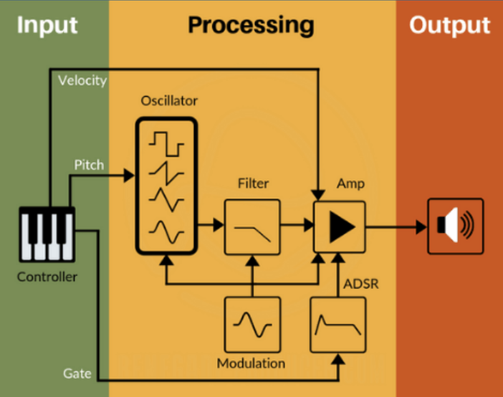
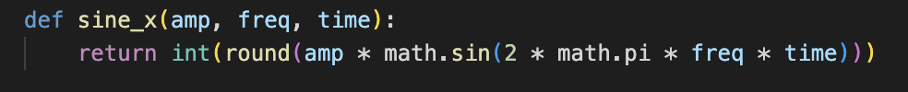
Music/Sound Synthesis
How do you generate sound?
Waveforms - sine waves!
Oscillators
Creates a signal that oscillates
Sine, square, sawtooth, and triangle
Amplitude ←
height of waveform
Loudness = larger, quietness = smaller
Frequency <-
Number of times a waveform repeats each second
Measured in hertz (Hz)
1 hertz = repeating 1 time per second
As hertz increases, so does pitch
Filters
Only letting certain frequencies pass through, smooths sound
Tried using a low-pass filter…
Sine wave generation!
Notes:
Essentially, I learned that these are the 4 ways you can generate and manipulate sound. I tried using filters, but didn’t end up getting it to work in time.
I decided to map the acceleration on the z-axis to amplitude and rotation on the x axis to frequency.

Slide 6
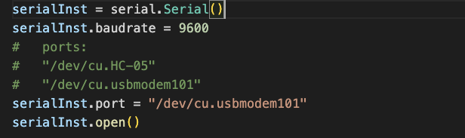
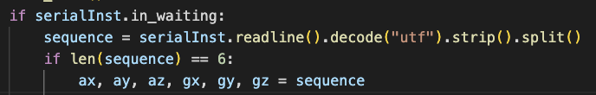
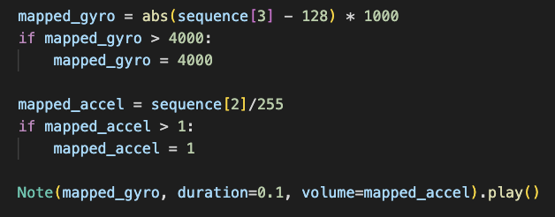
Mapping Data to Sound
Connecting serial port
← Reading serial data,
Parsing through data and splitting it
← Mapping the specific accel/gyro value and setting limits
← Putting the mapped value into the sound making

Slide 7
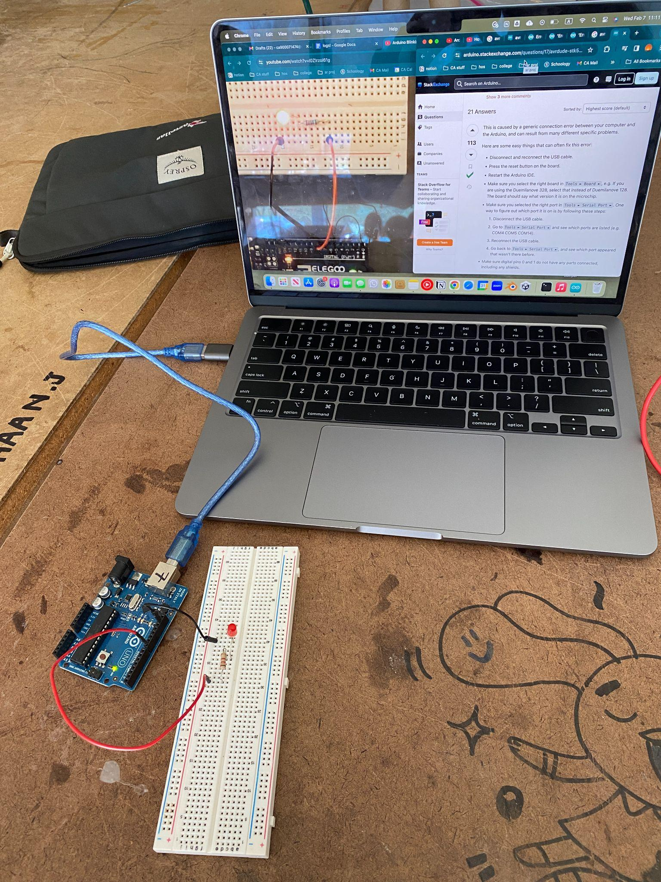
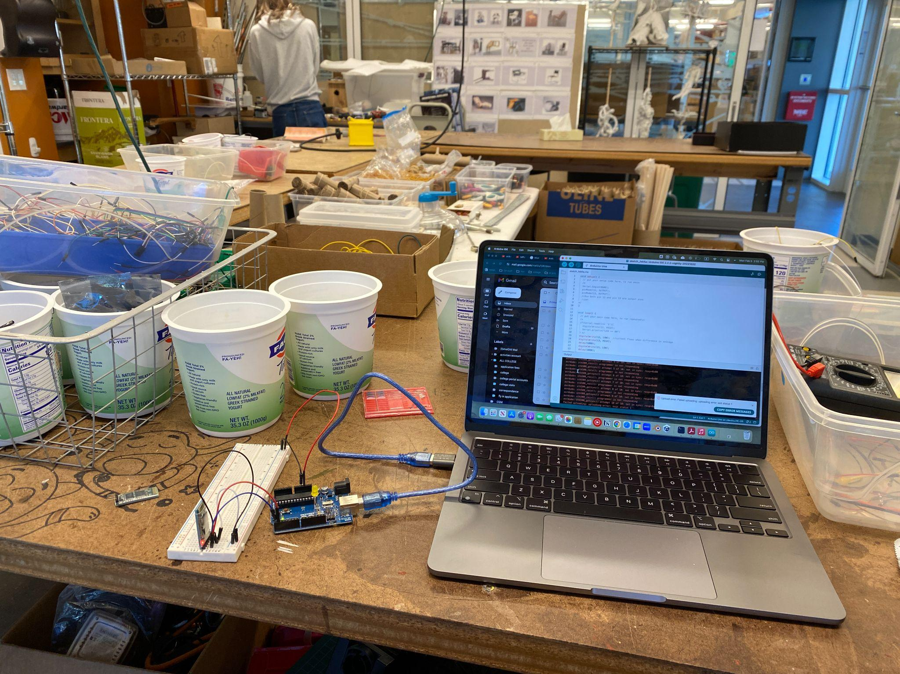
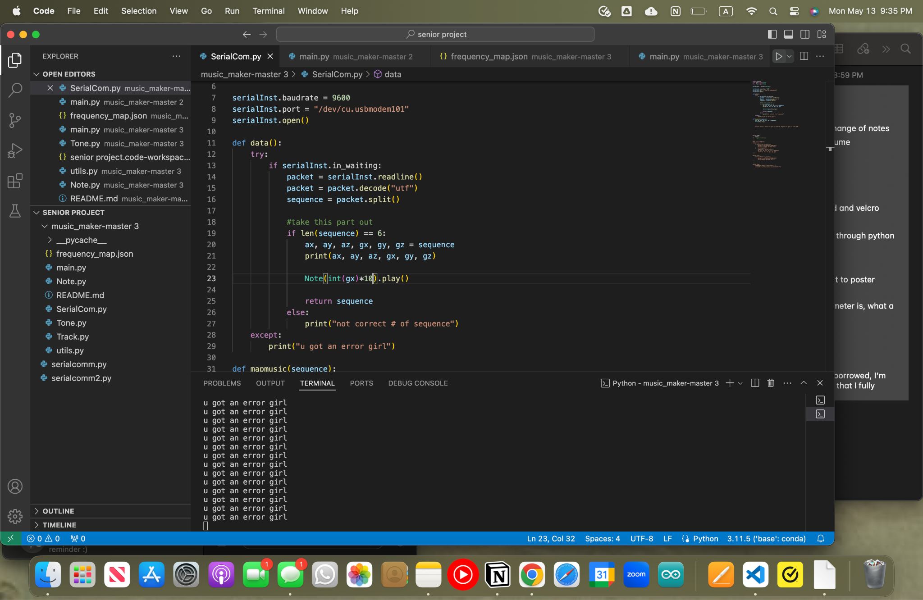
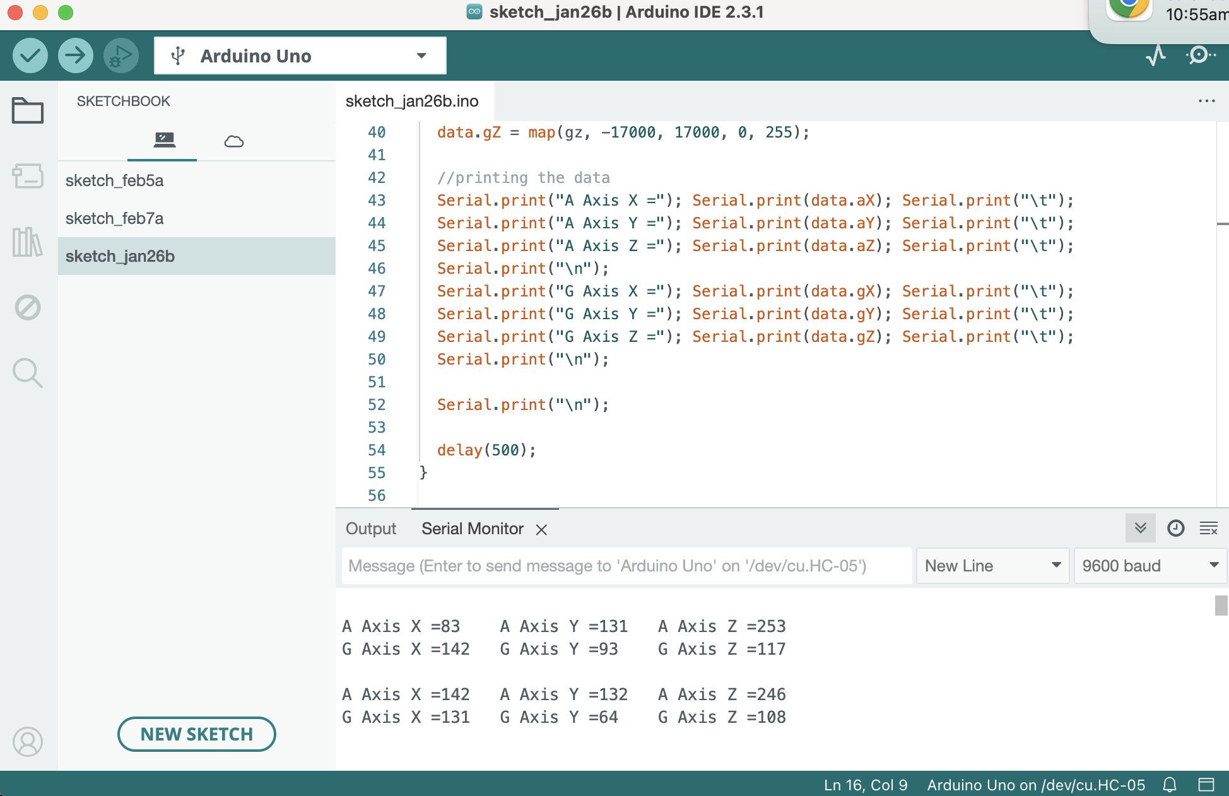
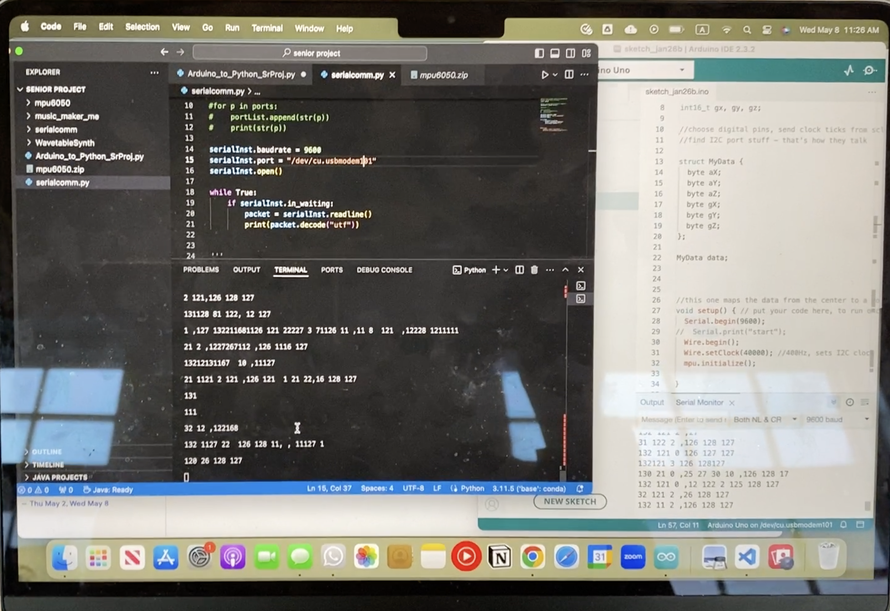
a selection of process pics
encountering challenges…
Early days learning to use Arduino (with LED pins too!)
Getting data from arduino to python!

Slide 8
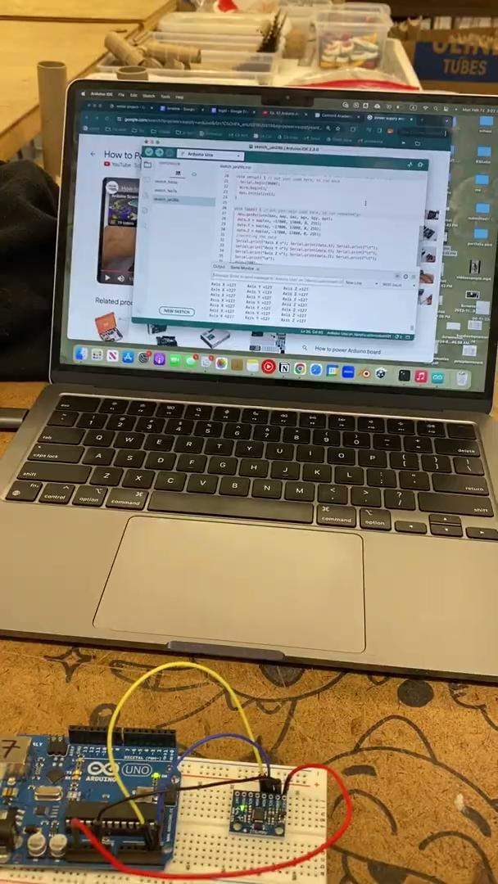

a selection of process vids
Getting data to upload from Arduino to Python
Receiving data from sensor

Slide 9
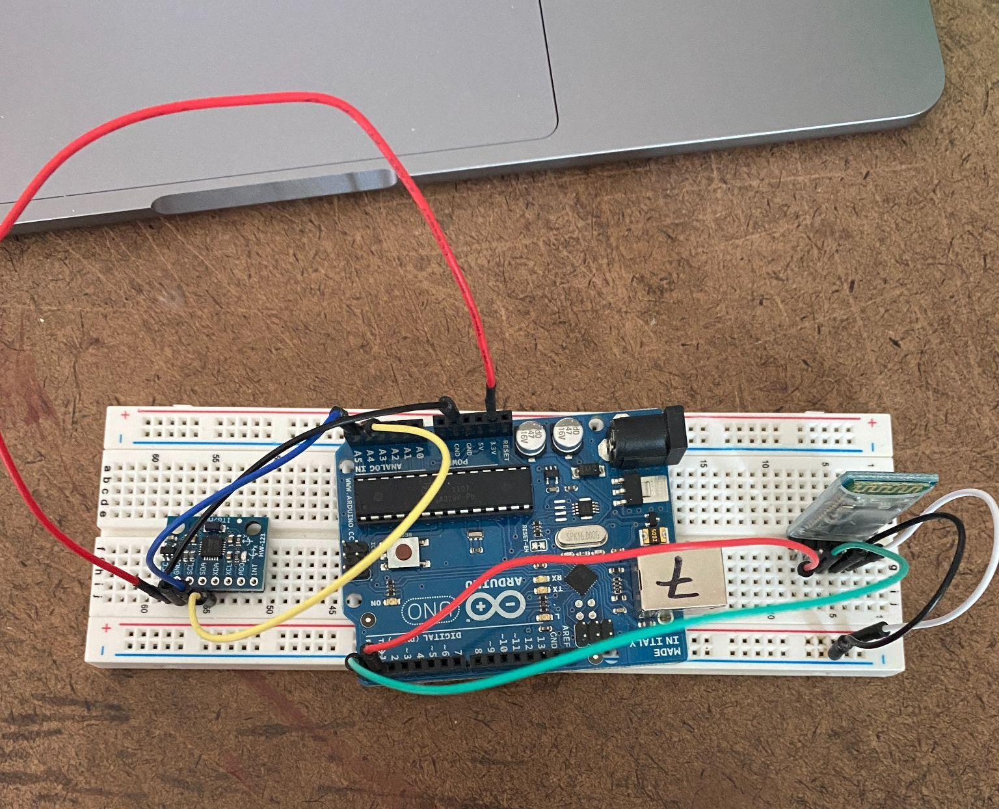
Improvements/Future Directions
Bluetooth + battery powered Encasement/packaging
Lilypad microcontroller → improves wearability
Generate different types of mapping for data to sound
Different instruments?
Tried using bluetooth in the beginning
Notes:
I actually tried using bluetooth in the beginning, but the connection wasn’t as strong and inorder to move on I stuck with using the USB that connects to my laptop as the power source and connector

Slide 10
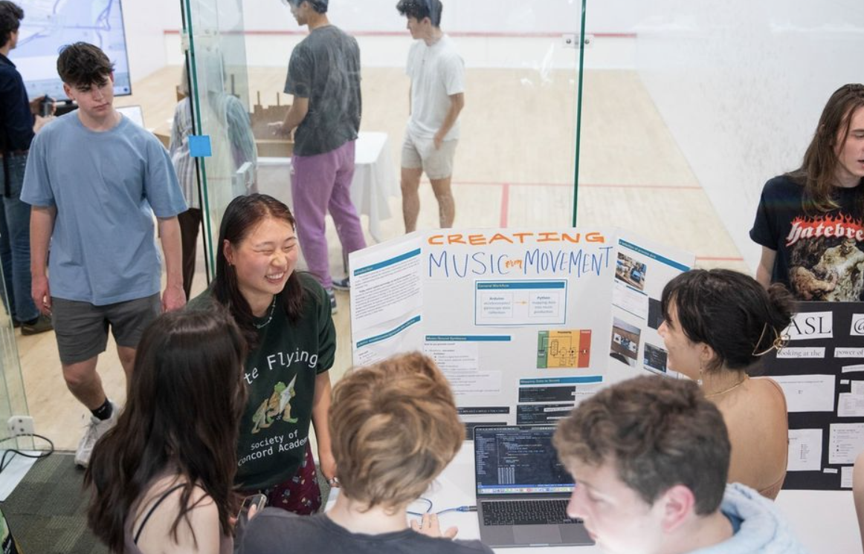
Final Product
Presentations!
Senior Project Logs documenting my experience
Code in senior project folder
Pitch changes when rotating about x-axis, volume changes based on movement upwards, but the sensor is oscillating between 0 and max volume currently so it’s harder to hear the volume changes

Slide 11
Works Cited
Explanations on accelerometers and gyroscopes:
https://lastminuteengineers.com/mpu6050-accel-gyro-arduino-tutorial/
Explanations on serial and I2C communication:
https://docs.arduino.cc/learn/communication/wire/
https://electronoobs.com/eng_circuitos_tut36.php#:~:text=Another%20very%20useful%20synchronous%20serial,and%20SCL%20(Serial%20Clock)
Python Music Synthesis code that I borrowed from and modified:
https://github.com/JamminCoder/music_maker
MPU6050 wiring and sensor code I borrowed and modified (I also used code from the MPU 6050 library):
https://www.youtube.com/watch?v=a37xWuNJsQI
AI transparency statement: I mentioned this to Max early on in the project, but I did use Chat-GPT (as an addition to common coding resources such as Stackoverflow and Google) during the coding process to help me debug errors, understand how some code I find online works, and work through areas that I spent a long time struggling with. I always tried to work through any struggles or challenges on my own, and never using it as a first resort or copying and pasting directly from Chat-GPT. I made sure I typed out any borrowed code myself into my files and understood what each part did, following the AI policy that is being used in Ben Stumpf’s computer science classes, one that allows coders both develop their own coding capabilities as well as prepare coders to utilize rapidly growing technology as a learning tool.

